Slide 1
Exercise 5
Video Guide

Slide 2
Outline
Problem Analysis
How polymorphism works?
Issues that polymorphism try to solve
Coding
Setup Inheritance and polymorphism
Show a list of shapes
Select a shape with a mouse click
Move the selected shape

Slide 3
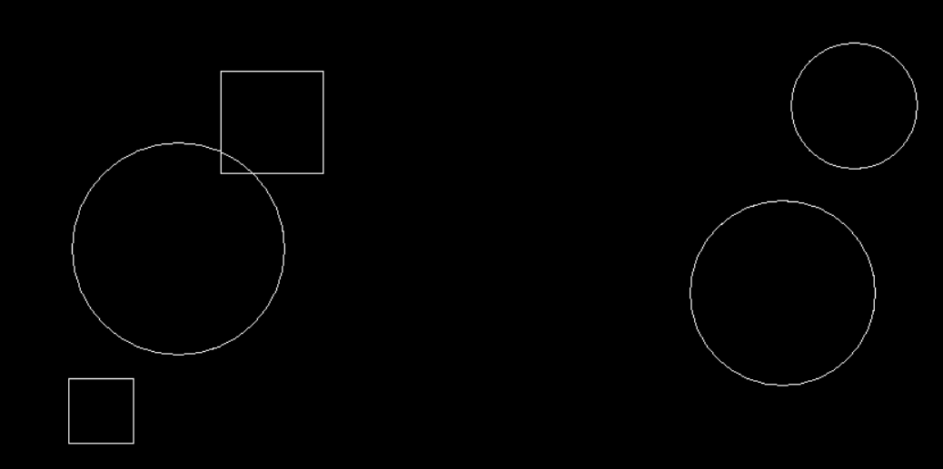
Problem Analysis – Identify Objects

Slide 4
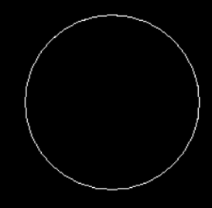

Problem Analysis – Classify objects to Classes
Circle
Rect

Slide 5
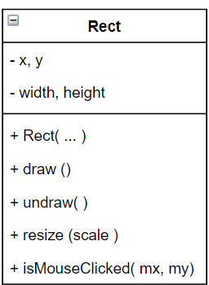
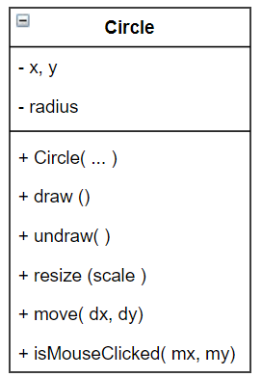
Design the classes

Slide 6
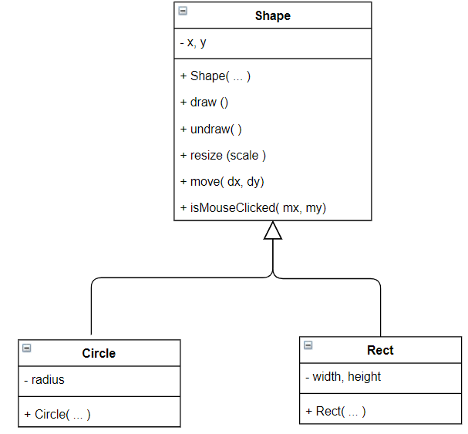
Apply Inheritance (i.e., Generalizing classes)

Slide 7
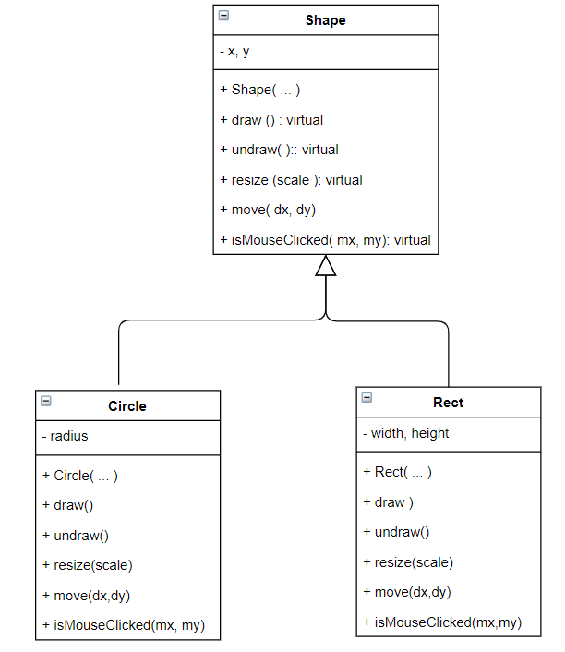
Apply Polymorphism Circle and Rect objects perform the same action (e.g., draw() ), however the way they behave (or do the action) are different.

Slide 8
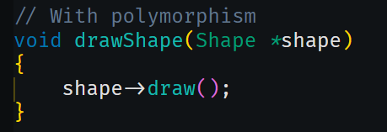
How polymorphism works?
Polymorphism allows “performing the same action but may behave differently”
e.g. code:
shape->draw()
The draw() above may be drawing a circle or a rectangle, depending on the pointer shape. If the pointer is currently pointing to a circle, then it draws a circle, and if it is pointing to a rectangle, then it draws a rectangle.

Slide 9
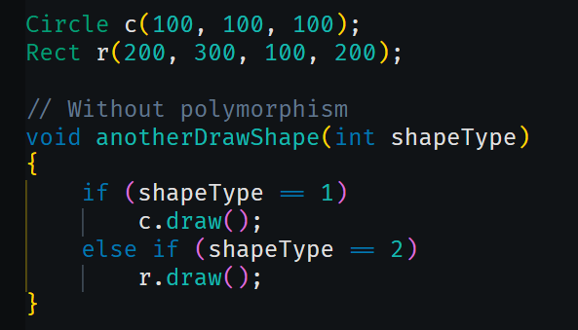
Issues that Polymorphism try to solve
Without polymorphism we need to explicitly determine the object type before invoking the draw() method.
Normally done with the selection structure like if … else / or switch

Slide 10
Setup Polymorphism
Organize classes in inheritance structure
Child classes override the parent methods
Parent class methods declared as virtual
Manipulate the objects using pointer of parent class

